Slide 1


Team 24: Pyro Sensor
Bi-Weekly Update 4 Alfonso Wong
Martin Ford
Oscar Hernandez Sponsor: Rhett Guthrie TA: Niloofar Borzooei
Notes:
Michelle

Slide 2
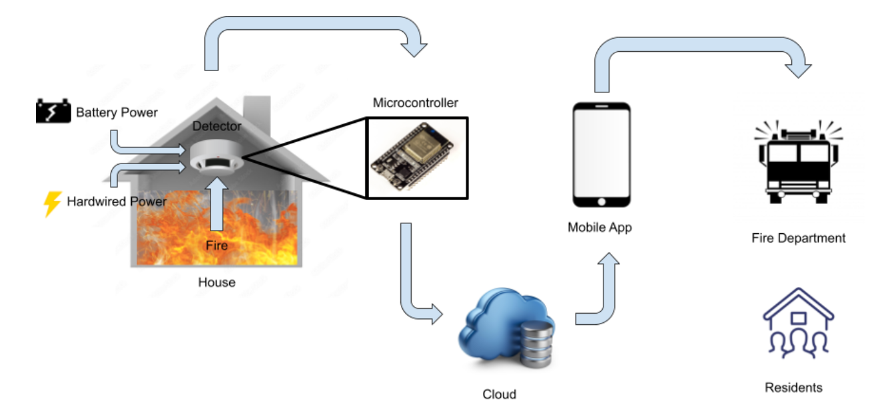
Project Summary
Problem statement:
Modern smoke detectors do not directly notify the emergency responders
Fire department has limited data of residents in buildings
Our Pyro Sensor will:
Notify any user and emergency responders instantly through a mobile app of any incident
Give fire department information about residents and pets
Notes:
Kyle

Slide 3
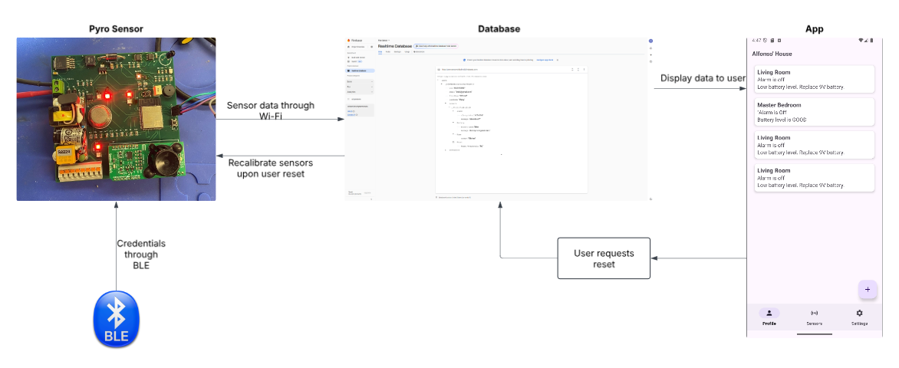
Integrated System Diagram

Slide 4
Project Timeline
Integration of mobile app and MCU (completed 2/28) | Subsystem Designs and Testing (completed 3/1) | Integration of Hardware and MCU (completed 3/2) | Final Integration (completed 3/2) | Full System Test (to complete by 3/20) | Validation (to complete by 4/3) | Demo and Report (to complete by 4/24)
Notes:
Eric

Slide 5
Martin Ford
Accomplishments since last update 21 hrs of effort | Ongoing progress/problems and plans until the next presentation
Soldered and tested PCB Completed subsystem integration: Solved linked sensor signals Calibrated signals to MCU Verified full sensor-to-alarm process | Continue testing and validation under different conditions Alarm volume testing Power source testing

Slide 6
Oscar Hernandez
Accomplishments since last update 27 hrs of effort | Ongoing progress/problems and plans until the next presentation
Updated BLE code to allow multiple connection attempts and fixed issue preventing connections to open networks Verified that latency from Firebase to app is less than 1 s. Improved accuracy of ADC readings based on oscilloscope measurements from the new PCB | Adding multiple devices test to a user profile. False alarm test to ensure the buzzer isn't triggered by non-hazardous sources, and alarm signal is not sent to user. Verify quick notification time from fire detection to user alert.

Slide 7
Alfonso Wong
Accomplishments since last update 56 hrs of effort | Ongoing progress/problems and plans until the next presentation
The mobile application is back up and running and able to pull data from the database (Firebase) MCU can access mobile app database UI feature for adding device to app finished Pictures can know be uploaded App creates access code during workspace creation Firefighter’s sign in page Alert text message to central dispatcher(Twilio API) First half of firefighters in app view | Finish second half of fixing in-app view for firefighters Fire tracking feature with real-time data provided by MCU

Slide 8
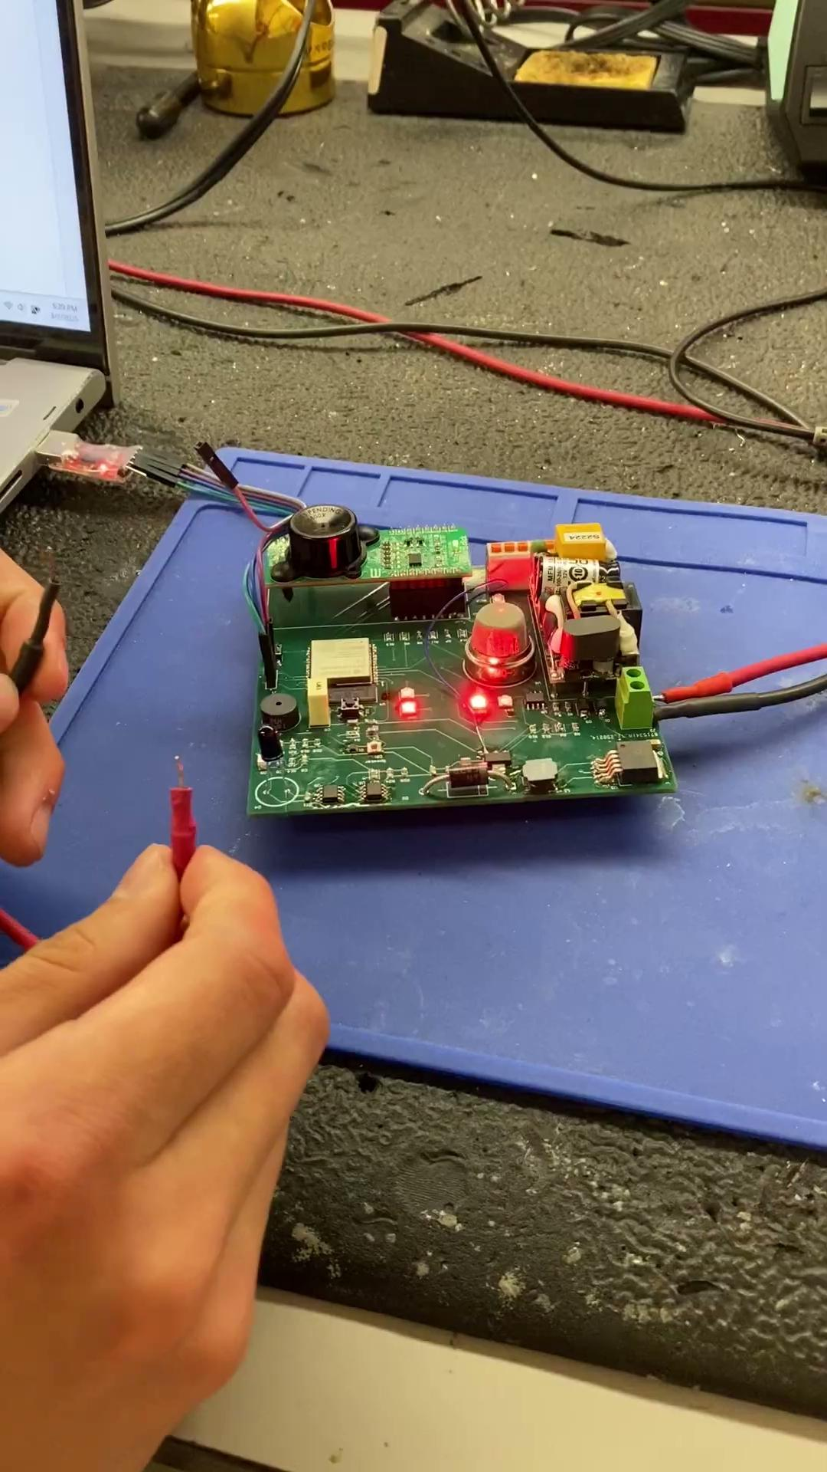
Sensor Functionality Test
Oscar Hernandez and Martin Ford
MCU reads precise voltages using the ADC and I2C.
The alarm goes off when the infrared sensor, ultraviolet sensor, and gas (MQ2) sensor are activated.
The alarm shuts off when it detects that none of the sensors have detected fire.

Slide 9
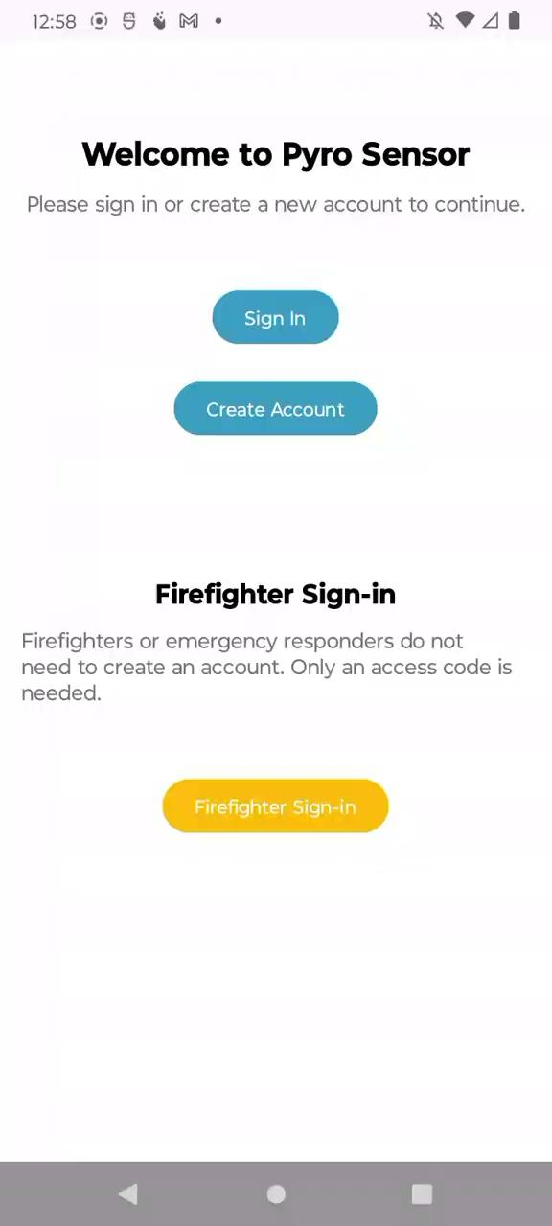
MCU-App Integration
Oscar Hernandez and Alfonso Wong

Slide 10
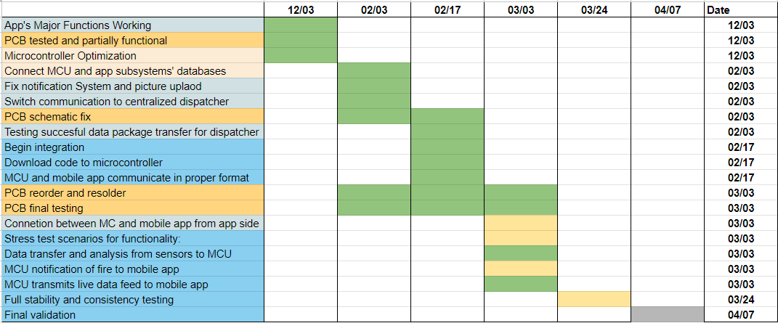
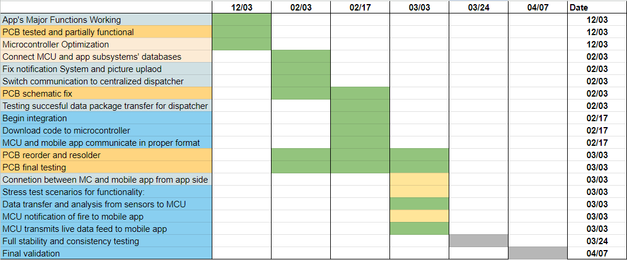

Execution Plan
Notes:
Michelle

Slide 11
Validation Plan
Paragraph # | Test Name | Success Criteria | Status | Responsible Engineers
3.2.1.1 | Sensor Functionality | Sensors detect smoke/flame at expected ranges and output a signal. | Tested | Martin Ford
3.2.2.6 | Speaker Functionality | Speaker emits sound from signal at >65 dB. | Untested | Martin Ford
3.2.2.5 | Operating Time | System operates and receives full power continuously for 1 hour on each power source. | Untested | Martin Ford
3.2.1.4 | Network | MCU is able to aggregate data from sensors to a Access Point. | Tested | Oscar Hernandez
3.2.1.14 | Trouble Signal | MCU sends trouble signal to app for malfunctions. | Tested | Oscar Hernandez
3.2.1.8 | User Profile Creation | User is able to create an account and be able to sign in. | Tested | Alfonso Wong
3.2.1.9 | Push Notifications | Be able to push notifications to users and send text to central dispatcher. | Tested | Alfonso Wong
3.2.1.10 | Design UI | Have a working UI and test with emulator. | Tested | Alfonso Wong
3.2.1.11 | Integrate Cloud Service | Mobile app has ability to pull data from cloud service and display it. | Tested | Alfonso Wong

Slide 12
Validation Plan
Paragraph # | Test Name | Success Criteria | Status | Responsible Engineers
3.2.1.6 | App compatible on Android devices | App can be used on most Android devices | Tested | Alfonso Wong
3.2.1.1 | MCU Peripherals Interface | MCU reads signals from all sensors, and activates/deactivates alarm. | Tested | Martin Ford & Oscar Hernandez
3.2.1.12 | Device and Application Communication | A new device can be added to user profile in application. | Untested | Alfonso Wong & Oscar Hernandez
3.2.2.13 | Real Time Communication | MCU is feeding constant information to database and it is being displayed in real time in mobile application. | Tested | Alfonso Wong & Oscar Hernandez
3.2.1.9 | Trigger Warning from MC | MCU must send a trigger alert of ongoing event and application must send notification to user and dispatch | Untested | Alfonso Wong & Oscar Hernandez
3.2.1.5 | Early Fire Detection | The system reduces the propagation of a fire by minimizing false alarms and notifying the user or fire department as soon as a fire is detected. | Untested | All
Notes:
*Marked MCU Peripherals Interface

Slide 13
Thank you for your attention!
Questions?

